Slide 1
Accuracy of the internal multiple prediction when the angle constraints method is applied to the ISS internal multiple attenuation algorithm.
Hichem Ayadi
San Antonio, Texas
May 1th-2th, 2013
Notes:
1
1

Slide 2
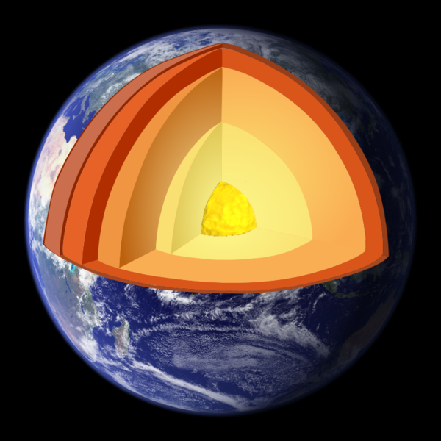
Mission – oriented seismic research program
Research framework
Target
IMAGING
MULTIPLE REMOVAL
PREPROCESSING
ISS for free surface and internal multiple removal
DATA
Deghosting
Wavelet estimation
Reference wave removal
Earth

Slide 3
motivation
The ISS internal multiple attenuator algorithm has received several positive attention for stand-alone capability for attenuating internal multiples in marine and off-shore plays.
Can we reduce the computational cost of the algorithm without affecting its efficacy and accuracy?

Slide 4
Key points
Presentation of a time saving method (angle constraints – P. Terenghi (2012)) applied to the ISS internal multiple attenuation algorithm.
Study, through a numerical analysis, of the accuracy of the internal multiple prediction (amplitude and shape).

Slide 5
outline
ISS internal multiple attenuation algorithm.
A time saving method based on two angular quantities.
Numerical analysis.
Conclusion.

Slide 6
outline
ISS internal multiple attenuation algorithm.
A time saving method based on two angular quantities.
Numerical analysis.
Conclusion.

Slide 7
ISS internal multiple attenuation algorithm
Many processing methods make assumptions and require subsurface information.
Assumptions satisfied: methods effective.
Assumptions not satisfied: methods have difficulty and/or fail.
In complex areas subsurface information can be difficult/impossible to satisfy.
The inverse scattering series state that all processing objectives can be achieved directly and without any subsurface information.

Slide 8
ISS internal multiple attenuation algorithm
Free-surface
Receivers
Source
1
Water
5
Earth
1. Primary 2. Source ghost 3. Receiver ghost
4. FS Multiple 5. Internal Multiple
From Zhiqiang Wang annual report (2012)

Slide 9
ISS internal multiple attenuation algorithm
The ISS internal multiple attenuation algorithm is a subseries of the Inverse Scattering Series:
(0) Input data $D(r_{g},r_{s},t)$
(1) The algorithm starts with the deghosted input data with the reference wavefield and free-surface multiples removed $D(k_{g},k_{s},ω)$.
We define $b_{1}(k_{g},k_{s},ω)$ which correspond to a form of f-k migration.
$k_{s}$, $k_{g}$ the horizontal wavenumber for the source and the receiver.
$q_{s}$, $q_{g}$ the vertical source and receiver wavenumber.

Slide 10
ISS internal multiple attenuation algorithm
(2) The second term in the algorithm is the leading-order attenuator $b_{3}$, which attenuates first-order internal multiples.
The leading-order attenuator in a 2D earth is given by,

Slide 11
ISS internal multiple attenuation algorithm
(4) Using the input data and the leading-order attenuator of the first-order internal multiples, the data with the first-order internal multiples attenuated is
Where,

Slide 12
outline
ISS internal multiple attenuation algorithm.
A time saving method based on two angular quantities.
Numerical analysis.
Conclusion.

Slide 13
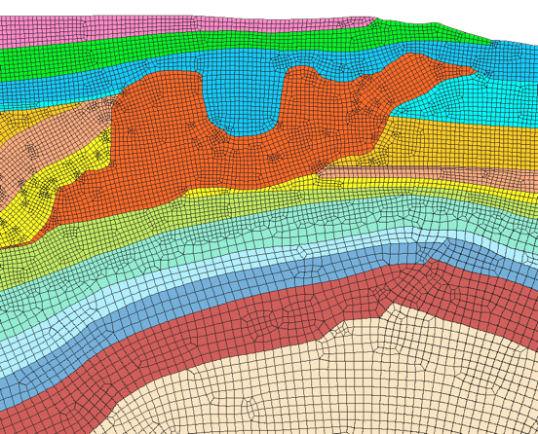
ISS INTERNAL MULTIPLE ATTENUATION WITH ANGLE CONSTRAINTS
ISS internal multiple attenuation algorithm has shown positive results for prediction all first-order internal multiples in marine and off-shore plays.
However, the ISS internal multiple attenuation algorithm can be a computationally demanding procedure.
P. Terenghi (2012) has proposed an approach based on certain angular quantities to control the accuracy and cost of the algorithm.
key control

Slide 14
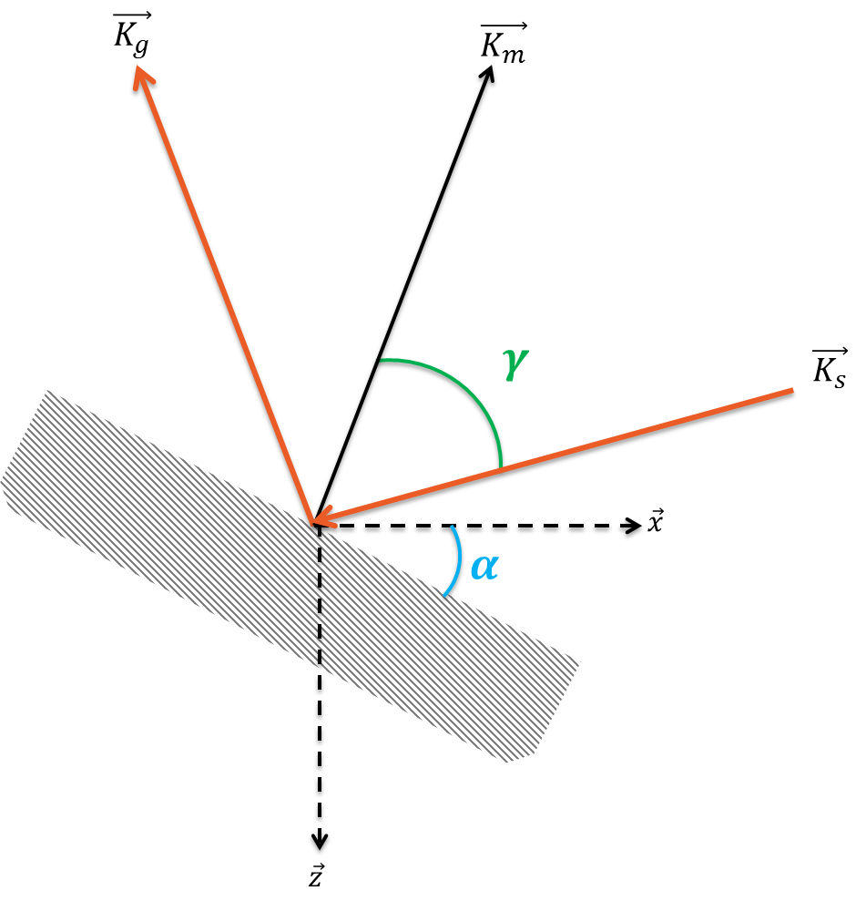
ISS INTERNAL MULTIPLE ATTENUATION WITH ANGLE CONSTRAINTS
Stolt and Weglein (2012) define the image function wavenumber as a difference between the receiver and source-side wavenumbers,
$$\vec{K_{m}}=\vec{K_{g}}−\vec{K_{s}}=\left\{\vec{k_{g}}−\vec{k_{s}},q_{g}−q_{s}\right\}$$
$$α=\tan^{−1}\left(\frac{\sqrt{\vec{k_{m}}.\vec{k_{m}}}}{\left|q_{g}−q_{s}\right|}\right)$$
$$γ=\frac{1}{2}\left(−\frac{c_{0}^{2}}{ω^{2}}(\vec{k_{g}}.\vec{k_{s}}+q_{g}q_{s})\right)$$
Reflector dip
Incident angle

Slide 15
ISS INTERNAL MULTIPLE ATTENUATION WITH ANGLE CONSTRAINTS
The leading-order attenuator in a 2D earth is given by,
With,

Slide 16
ISS INTERNAL MULTIPLE ATTENUATION WITH ANGLE CONSTRAINTS
It is possible to constrain the algorithm within a range of angular quantities,
The total frequency interval,
Using $α/γ$ and $ω$ monotonic relationship
Reduction of the number of loop

Slide 17
ISS INTERNAL MULTIPLE ATTENUATION WITH ANGLE CONSTRAINTS
Input Data $D(r_{g},r_{s},t)$
$$α\sim monotonic function of ω$$
$$γ\sim monotonic function of ω$$
D’
Data deghosted and FS multiple removed
$$D(k_{g},k_{s},ω)$$
Interval of wavenumber reduced
$$∫$$
$$b_{1}(k_{g},k_{s},ω)$$
$$b_{3}^{(α,γ)}(k_{g},k_{s},ω)$$
$$D_{3}^{\left(α,γ\right)}(k_{g},k_{s},ω)$$
$$D\left(r_{g},r_{s},t\right)+D_{3}^{\left(α,γ\right)}\left(r_{g},r_{s},t\right)$$

Slide 18
outline
ISS internal multiple attenuation algorithm.
A time saving method based on two angular quantities.
Numerical analysis.
Conclusion.

Slide 19
Numerical analysis
$$c_{1}=1500 m/s$$
$$z_{1}=1000 m$$
$$c_{2}=2700 m/s$$
Point source (6086 ; 910)
Number of receiver : 928
$$z_{2}=1300 m$$
$$c_{3}=4500 m/s$$
$$z_{3}=1700 m$$
$$c_{3}=6100 m/s$$

Slide 20
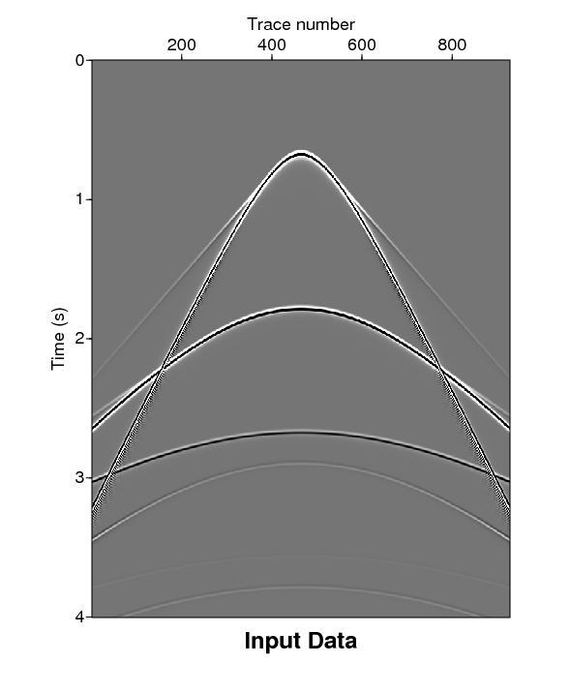
Numerical analysis
$$P_{1}$$
$$P_{1}$$
$$I_{323}$$
$$I_{313}$$
$$I_{212}$$
$$P_{2}$$
$$P_{3}$$
$$P_{2}$$
$$I_{212}$$
$$P_{3}$$
$$I_{323}$$
$$I_{313}$$
Note: Model made using final difference.

Slide 21
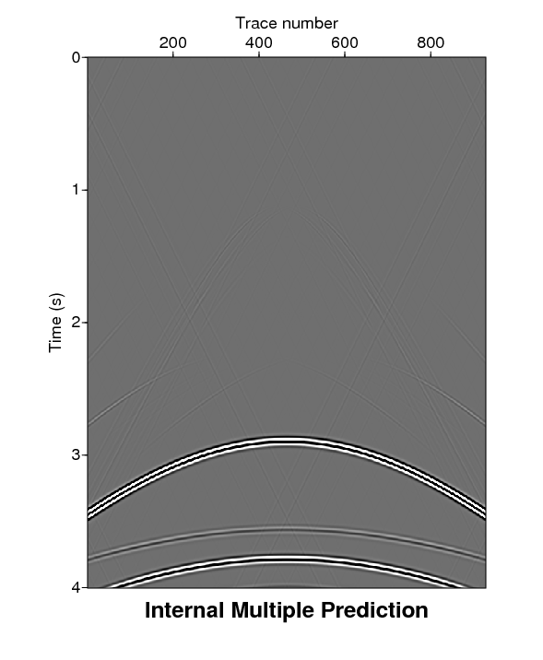
Numerical analysis
Internal multiple predicition - $b_{3}$
Using the ISS internal multiple prediction algorithm

Slide 22
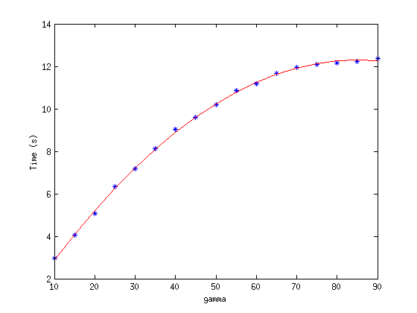
Numerical analysis

Slide 23
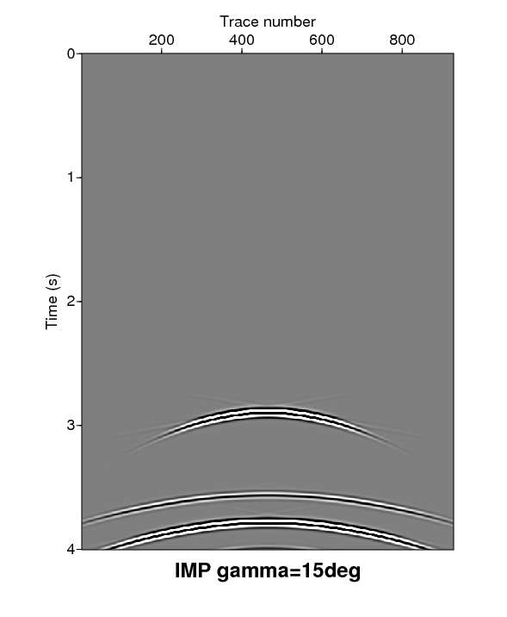
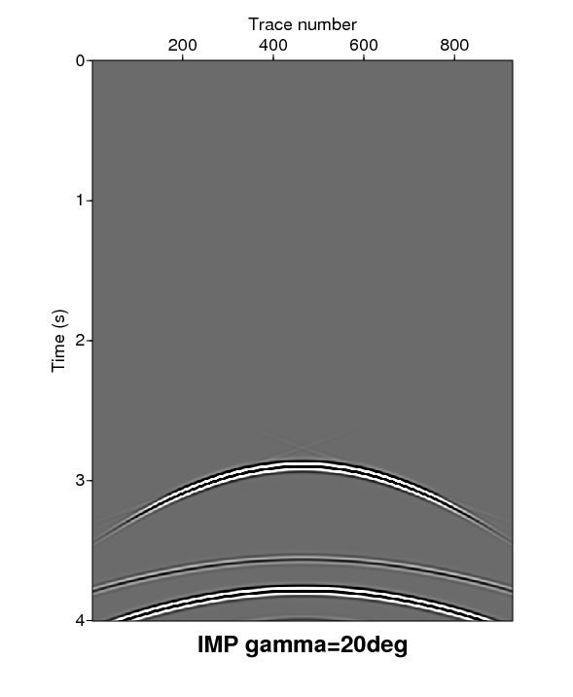
Numerical analysis
IMP - ${b_{3}^{}}^{γ}$- for different incident angle

Slide 24
Numerical analysis
IMP - ${b_{3}^{}}^{γ}$- for different incident angle

Slide 25
Numerical analysis
Amplitude analysis at zero offset

Slide 26
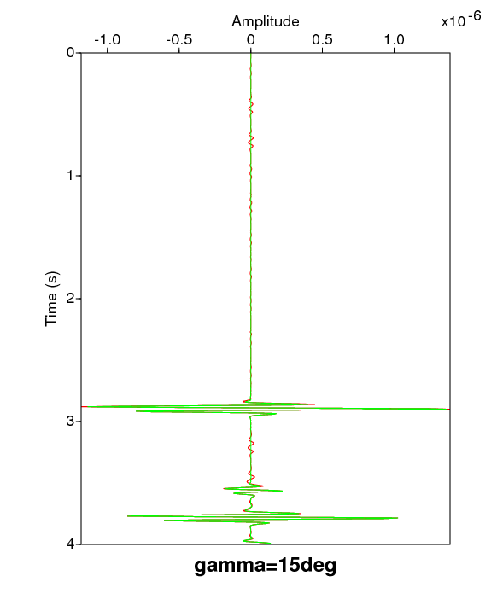
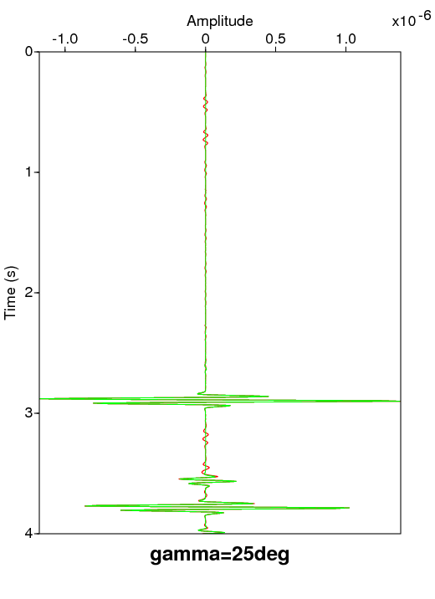
Numerical analysis
$b_{3}$ (full open angle)
$${b_{3}^{}}^{γ}$$

Slide 27
Numerical analysis
Amplitude analysis at 1405 m from offset

Slide 28
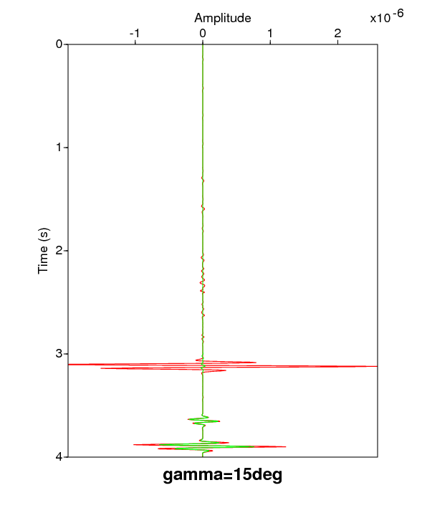
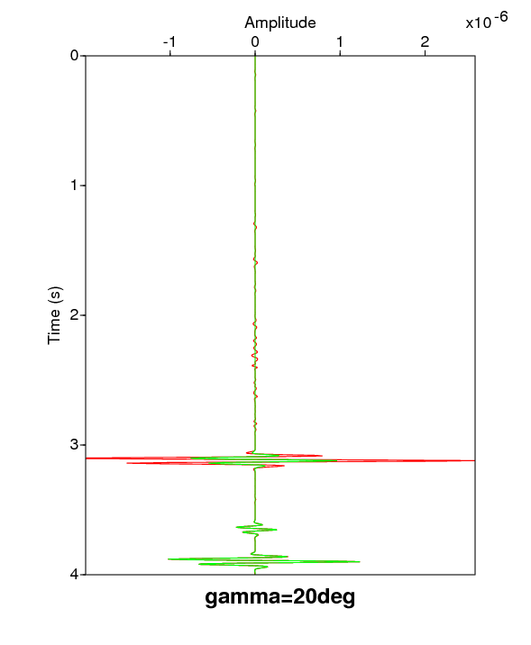
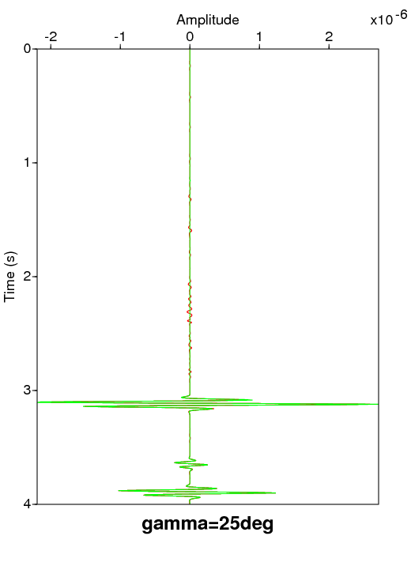
Numerical analysis
$b_{3}$ (full open angle)
$${b_{3}^{}}^{γ}$$
Amplitude comparison between $b_{3}$ and ${b_{3}^{}}^{γ}$ for different incident angle

Slide 29
Numerical analysis
$$÷2$$

Slide 30
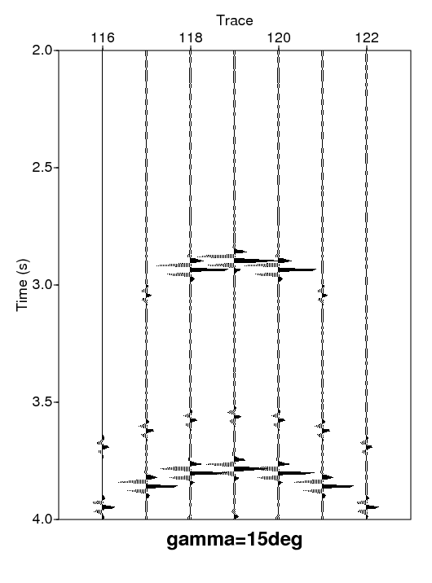
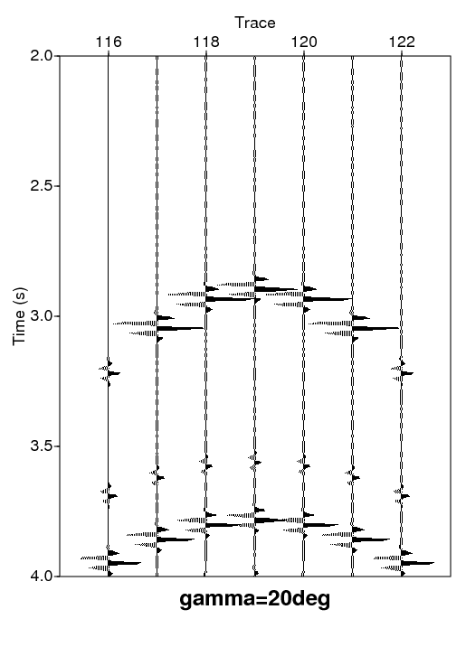
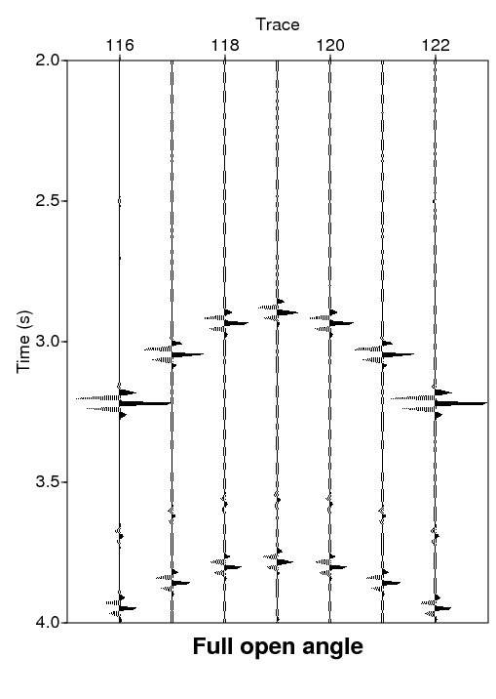
Numerical analysis
Note: Source at trace 119
Shape comparison between $b_{3}$ and ${b_{3}^{}}^{γ}$ for different incident angle

Slide 31
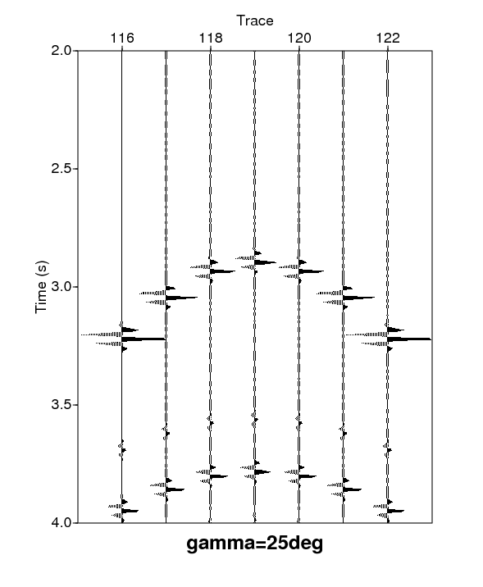
Numerical analysis
Note: Source at trace 119
Shape comparison between $b_{3}$ and ${b_{3}^{}}^{γ}$ for different incident angle

Slide 32
outline
ISS internal multiple attenuation algorithm.
A time saving method based on two angular quantities.
Numerical analysis.
Conclusion.

Slide 33
conclusion
The angle constraints method is a time-saving procedure for any algorithm defined in source and receiver transformed domain.
Studying the impact of the angle constraints on the ISS internal multiple attenuation algorithm, it appears that a compromise between the time saved and the accuracy has to be made.
Accuracy related with a certain ”angle limit”.
The range of integration chosen as a compromise of the required degree of accuracy and the computational time saving.
Next step of the study will be to identify this two angular quantities using the input data in order to define the constraints limits.

Slide 35
THANK YOU FOR YOUR ATTENTION

